Slide 1
Mental Health Services Data Set (MHSDS) Training session one
Carl Money – Senior Analytical Manager (Mental Health)

Slide 2
Training overview
Session one – introduction to the data set
Session two – the MHSDS in the National Commissioning Data Repository (NCDR)
Session three – querying the MHSDS

Slide 3
Session one overview
What is the MHSDS?
Structure, data model, technical output specification and user guide
Submission process
What can you use the MHSDS for?

Slide 4
What is the MHSDS?
The Mental Health Services Data Set (MHSDS) is owned and managed by NHS Digital. It collects person level data from the health records of individual children, young people and adults who are in contact with mental health and learning disability services
The data is re-used for purposes other than their direct care and as such is referred to as a secondary uses data set
It defines data items, definitions and information extracted or derived from local information systems
Submission to the MHSDS is mandatory where the person’s care is NHS funded
https://digital.nhs.uk/data-and-information/data-collections-and-data-sets/data-sets/mental-health-services-data-set
Notes:
Talk about the

Slide 5
What is the MHSDS?
The MHSDS is regularly updated (typically annually). This ensures that the data set is kept fit for purpose
Recent changes include the addition of data items and tables to support initiatives linked to the NHS Long Term Plan
The MHSDS is increasingly using clinical terminology to capture clinical information, primarily through SNOMED-CT
This allows the data set to be more responsive to change and enables greater interoperability

Slide 6
Who submits data to the MHSDS?
In short, any organisation that delivers NHS funded care for a person’s mental health and wellbeing, excluding Adult IAPT services
This includes those large NHS organisations you’d expect, who account for around 90 – 95% of all the activity reported
But increasingly includes Voluntary Care Services, Independent Sector organisations, Councils and charities
NHS Digital receive submissions from over 300 organisations each month

Slide 7


What services does the MHSDS include?
Organic and functional community mental health teams
Acute inpatient care
Psychiatric intensive
care
Crisis and liaison services
H
Children and Young People’s services
LDA inpatient care
Inpatient services
Community services
Specialist inpatient care
Specialist community services
Forensic and secure inpatient care
Triage and SPA services

Slide 8
What is the MHSDS?
Structure, data model, technical output specification and user guide
Submission process
What can you use the MHSDS for?

Slide 9
MHSDS structure and data model
The MHSDS is a complex relational data set with almost 60 tables and around 1,000 individual data items
The MHSDS is modular – groups of tables may not be submitted depending on the services delivered by the provider
The MHSDS is referral based, which allows us to track individual clinical pathways
The data model is a pictorial representation of this structure

Slide 10
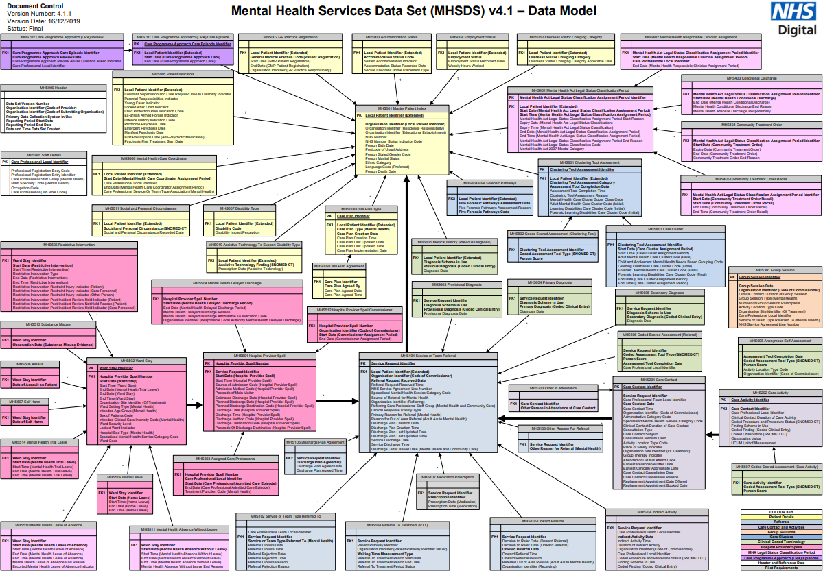
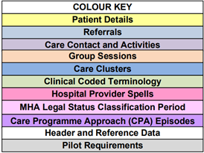
Notes:
This is the input data model!

Slide 17
MHSDS technical output specification
The most helpful file when analysing the MHSDS
An Excel file with a tab for each table and information on each data item (format, national code list, etc)
Contains a lookup table for assessments, a change log and table linkage guidance
Also includes information on file, table and data item level rejections
Implement the Mental Health Services Data Set - tools and guidance - NHS Digital

Slide 18
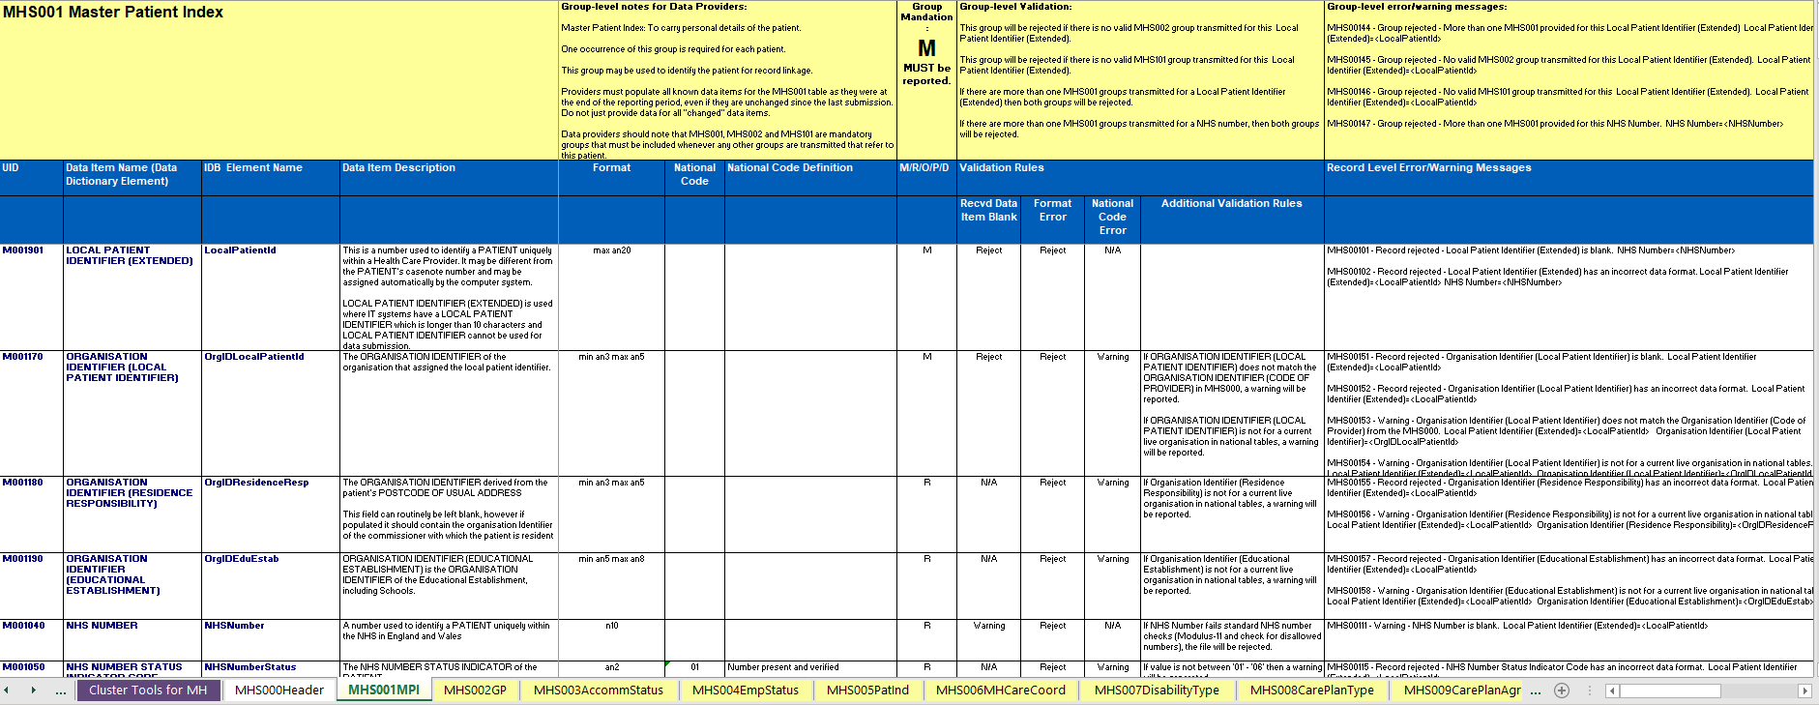
MHSDS technical output specification

Slide 19
MHSDS user guide
A PDF of guidance for each table and often individual data items
Includes the history of scope and format changes
Outlines how the MHSDS should be used and interpreted by users, system suppliers and other stakeholders
Provides additional information on data groups and data items, along with additional guidance regarding the extraction and analysis of the data set

Slide 20
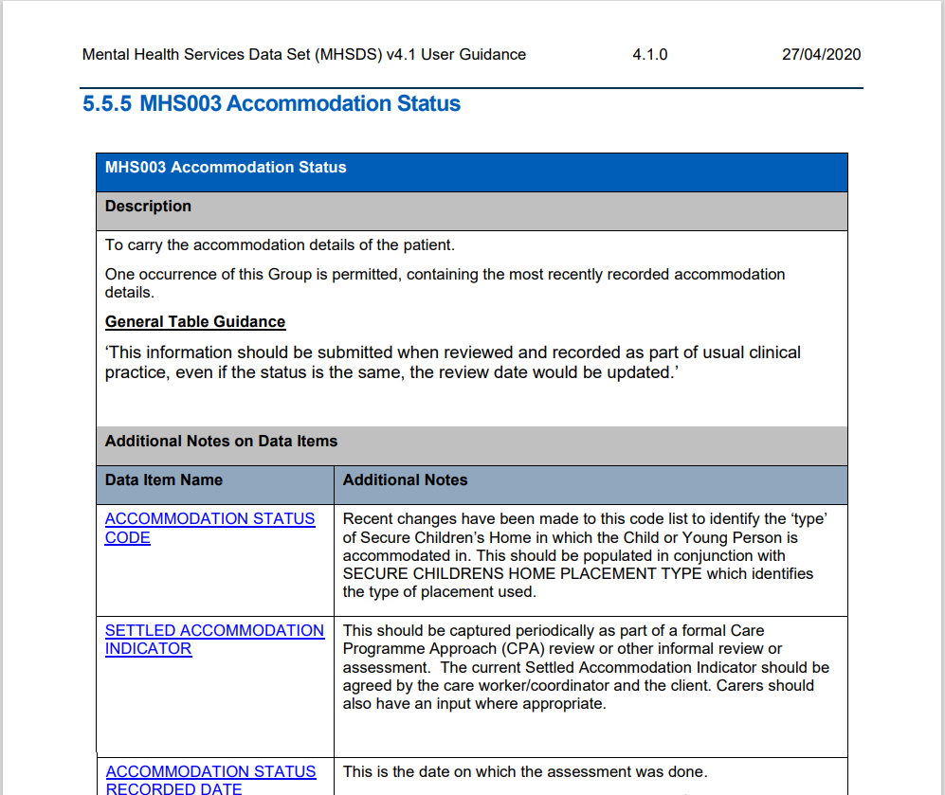
MHSDS user guide

Slide 21
What is the MHSDS?
Structure, data model, technical output specification and user guide
Submission process
What can you use the MHSDS for?

Slide 22















MHSDS submission process
Excel
PAS
SDCS Cloud
H
Paper records
Intermediate Database (IDB)
Aggregate
extracts
Record level
extracts
Publications

Slide 23
MHSDS submission process
Data is submitted monthly to the MHSDS
Includes all data relevant to the reporting period – NOT JUST FINISHED EPISODES
Month 1
Month 2
Month 3
Month 4
Month 5
Month 6

Slide 24
MHSDS submission process
Until recently, there were only two opportunities to submit data to the MHSDS
Primary
Refresh
From v4 (2019/20) providers have been able to resubmit previous data at any point in the financial year under certain circumstances
That means 13 opportunities to submit April data
But still only a maximum of two chances for March
Notes:
a new provider starts submitting data mid-year for the first time
an issue was identified in a provider’s submission for that month that requires resubmission
the resubmission of a particular month’s data has resulted in data associated with earlier or later months being impacted

Slide 25
Reporting period
 | April | May | June | July | August | September | October | November | December | January | February | March
April | ✅ | ✅ | ✅ | ✅ | ✅ | ✅ | ✅ | ✅ | ✅ | ✅ | ✅ | ✅
May |  | ✅ | ✅ | ✅ | ✅ | ✅ | ✅ | ✅ | ✅ | ✅ | ✅ | ✅
June |  |  | ✅ | ✅ | ✅ | ✅ | ✅ | ✅ | ✅ | ✅ | ✅ | ✅
July |  |  |  | ✅ | ✅ | ✅ | ✅ | ✅ | ✅ | ✅ | ✅ | ✅
August |  |  |  |  | ✅ | ✅ | ✅ | ✅ | ✅ | ✅ | ✅ | ✅
September |  |  |  |  |  | ✅ | ✅ | ✅ | ✅ | ✅ | ✅ | ✅
October |  |  |  |  |  |  | ✅ | ✅ | ✅ | ✅ | ✅ | ✅
November |  |  |  |  |  |  |  | ✅ | ✅ | ✅ | ✅ | ✅
December |  |  |  |  |  |  |  |  | ✅ | ✅ | ✅ | ✅
January |  |  |  |  |  |  |  |  |  | ✅ | ✅ | ✅
February |  |  |  |  |  |  |  |  |  |  | ✅ | ✅
March |  |  |  |  |  |  |  |  |  |  |  | ✅
Data month

Slide 26
What is the MHSDS?
Structure, data model, technical output specification and user guide
Submission process
What can you use the MHSDS for?

Slide 27
What can you use the MHSDS for?
The MHSDS has a number of uses including for:
commissioning services
clinical audit
research
service planning
inspection and regulation
monitoring government policies and legislation
local and national performance management and benchmarking
national reporting and analysis
Notes:
Used by policy makers
commissioners
mental health service users
members of the public

